Slide 1
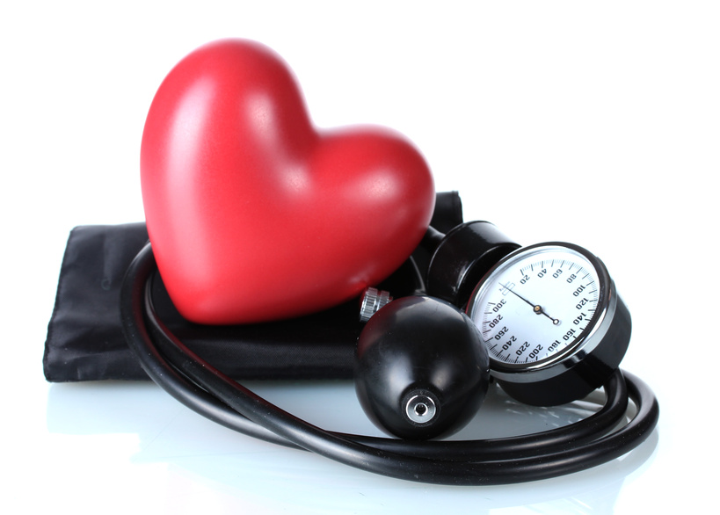
Hypertension-a silent killer
Dr. S. Abdul Azeez MBBS, DPH
Ministry of Health, Riyadh

Slide 2
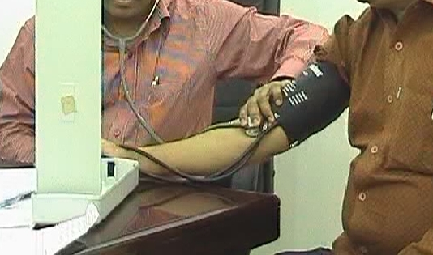
Blood pressure
BP is the physical force exerted by the blood as it
pushes against the walls of the arteries
Normal blood pressure: 120/80 mms of Hg.
The higher number is the systolic pressure &
the lower number is the diastolic

Slide 3
High blood Pressure (hypertension)
Classification:
Pre hypertension
BP just above the normal level (A WARNING SIGN)
a systolic pressure : 120 and 139 or a diastolic pressure of 80 to 89
Hypertension
BP above 140/90 or higher (DANGER ZONE)
hypertensive crisis
BP 180/110 mms. Of Hg or higher
(A SERIOUS CONDITION)

Slide 4
High blood Pressure (hypertension)
Classification:2
Primary (essential) hypertension
there's no identifiable cause - tends to develop
gradually over many years
Secondary hypertension
caused by an underlying condition
-tends to appear suddenly
-higher blood pressure than does primary hypertension
Kidney problems/Adrenal gland tumors/
Certain congenital defects in blood vessels/
Medications: birth control pills, cold remedies, decongestants, over-the-counter pain relievers and some prescription drugs/
Illegal drugs: cocaine and amphetamines

Slide 5
Pre hypertension
a systolic pressure : 120 and 139 or a diastolic pressure of 80 to 89
A Warning Sign
have two times the risk of heart disease compared with those who have lower blood pressures.
Lifestyle changes can help many people with pre hypertension to lower their blood pressure.

Slide 6
Hypertension-High Blood Pressure (HBP)
BP above 140/90 mms of Hg or higher
DANGER ZONE
Patient may not have any symptoms
damage the walls of the arteries & increases the risk of heart disease,
kidney disease, and stroke
HYPERTENSIVE CRISIS
BP 180/110 mms of Hg or higher
(A SERIOUS CONDITION)
Symptoms: anxiety, nose bleeds, severe headache, and shortness of breath
can lead to stroke, kidney damage, heart attacks, or loss of consciousness

Slide 7
Why Hypertension a silent killer ?
it may have no outward symptoms for years
one in five people with hypertension don't know
they have it
quietly damage the heart, lungs, blood vessels,
brain, and kidneys if left untreated
It's a major risk factor for strokes
and heart attacks

Slide 8
The problem
world
One third of world population is hypertensive
>50% of adults above 50 years age are hypertensive
10% of population in age group 20-30
Problem is decreasing in the developed world, but increasing in developing world
India
rapidly becoming the capital of hypertension
23% above the age of are hypertensive
HTN causes 53% stroke deaths and 45% cardiac death
Kerala
> 24% villagers in Kerala are hypertensive
110 people die every day due cardiovascular disease (50%of total deaths ; become 2/3 of total death by 2020)

Slide 9
Who Gets High Blood Pressure?
more common in older people
At age 45-65 , more men have hypertension than women. By age 65, this is reversed
Diabetics have a greater risk of hypertension
About 60% of all people with diabetes
also have hypertension
a close family member with high blood pressure
also increases your risk

Slide 10
Gestational hypertension
high blood pressure that develops in pregnancy
If not properly managed
preeclampsia
elevated blood pressure and the leakage of protein into the urine by the kidneys
dangerous to both mother and baby
After the baby is born, high blood pressure of pregnancy usually returns to normal levels

Slide 11
Hypertension and Children
The normal blood pressure of a child dependent
upon the child’s age, gender, and height.
Children are at higher risk for hypertension if
they are overweight, are African-American or if
they have a family history of hypertension
Your doctor can tell if your child’s
blood pressure is abnormal

Slide 12
Risk factors of hypertension
Race: African-Americans
Dietary factors :
High salt intake >1,500 mg/day Processed foods like lunch meats and canned soups
Stress
poor nutrition, alcohol use, and smoking
overweight /sedentary life /smoking
'White Coat' Hypertension: anxiety or nervousness
Certain medications: flu medications that contain decongestants , steroids, diet pills, birth control pills, pain relief medications, antidepressants, herbal medications or diet supplements

Slide 13
symptoms
Most people with high blood pressure have no signs or symptoms
people with early-stage high blood pressure may have dull headaches, dizzy spells, nose bleeds etc.
These signs and symptoms typically don't occur
until high blood pressure has reached
a severe - even life-threatening -stage.

Slide 14
Complications 1
Heart attack or stroke
HBP can cause hardening and thickening of
arteries –atherosclerosis-that lead to
heart attack, stroke or other complications
Aneurysm
Increased blood pressure causes blood vessels to weaken and bulge, forming an aneurysm
an aneurysm ruptures can be life-threatening.
Heart failure
Due to HBP, the heart muscle gets thickened & hard
and extra pumping strain lead to heart failure.
Weakening/narrowing of blood vessels of kidneys
This can prevent these organs from functioning normally.

Slide 15
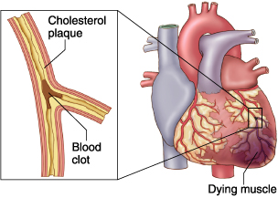
Heart attack

Slide 16
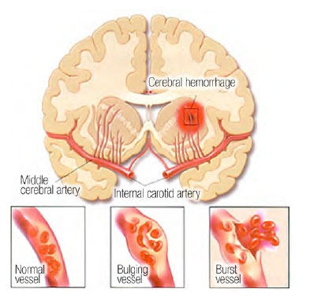
Stroke

Slide 17
Complications 2
vision loss
Thickened, narrowed or torn blood vessels in the eyes
Metabolic syndrome
This syndrome is a cluster of disorders of your body's metabolism — including increased waist circumference, high triglycerides, low high-density lipoprotein (HDL), or "good," cholesterol, high blood pressure, and high insulin levels.
If you have high blood pressure, you're more likely to have other components of metabolic syndrome.
The more components you have, the greater your risk of developing diabetes, heart disease or stroke.
Trouble with memory or understanding
Uncontrolled HBP affect ability to think, remember and learn. Trouble with memory or understanding concepts is more common in people who have high blood pressure.

Slide 18
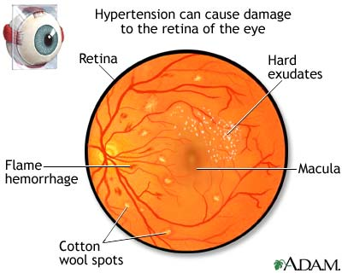
Eye problems

Slide 20
Treatment -1
1. Diet
The DASH Diet
(Dietary Approaches to Stop Hypertension)
diet designed to promote lower blood pressure
The DASH diet recommends eating more vegetables, fruits, whole grains, low-fat dairy products, poultry, nuts, and fish
Red meat, saturated fats, and sweets should be avoided. It can also help to reduce your intake of sodium

Slide 21
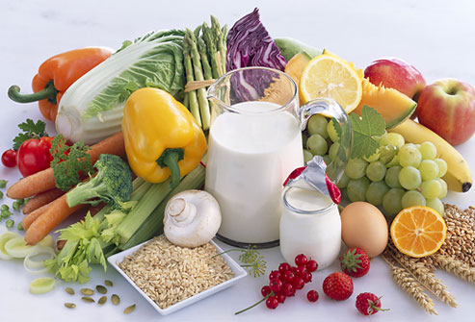
Increasing intake of lean protein, fiber, fruits, and vegetables give protection against development of hypertension

Slide 22
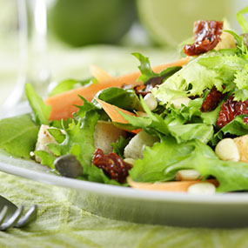
Smart eating

Slide 23
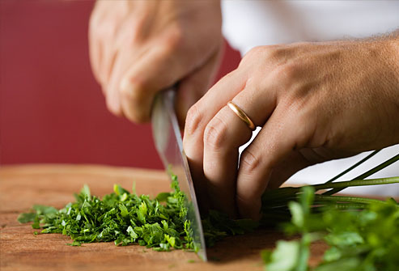
Salt restriction

Slide 24
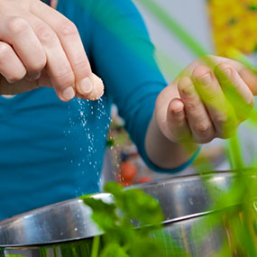
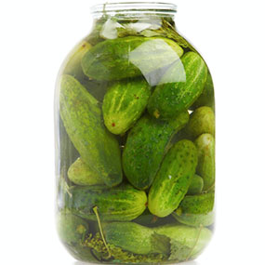
Pickles
Preserving any food requires salt to stops the
decay and keeps it edible longer. thus salt
can make even the most innocent cucumber
a sodium sponge
The longer vegetables sit in canning and preserving liquids, the more sodium they can pick up

Slide 25
diets to be avoided
Frozen Pizza
All pizzas can be bad for those watching their sodium intake. The combination of cheese, cured meats, tomato sauce, and bread adds up the milligrams quickly
frozen pizza is especially dangerous for hypertensive people
One-sixth of a frozen pizza can be as much as 1,000 milligrams, sometimes even more. The thicker the crust and the more toppings you have, the higher your sodium number will climb

Slide 26
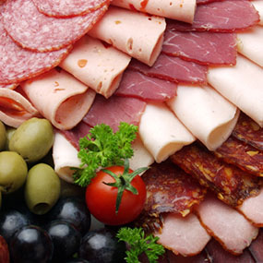
Diet to avoid
Deli Meat
Processed deli and lunch meats often are cured, seasoned, and preserved with salt and are real sodium bombs. A two-ounce serving of some lunch meats could be 600 milligrams of sodium or more .
Add bread, cheese, condiments, and pickles, and your simple sandwich can quickly become a sodium trap.

Slide 28
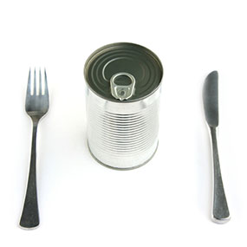
Canned Soups
canned soups are filled with sodium
Some soups can have 890 milligrams of sodium or more in just one serving. If you consume the entire can, you’ll be taking in 2,225 milligrams of sodium.
A better option is to make your own from a low-sodium recipe to keep the salt in check.

Slide 29
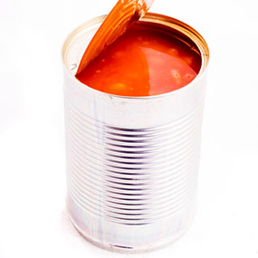
Canned or Bottled Tomato Products
Bottled tomato products are problematic for people with hypertension
Canned tomato sauces, pasta sauces, and tomato juices are all high-sodium culprits

Slide 30
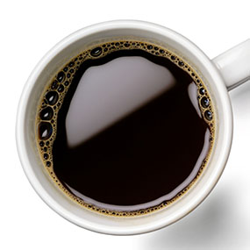
Coffee
Hypertensive & pre hypertensive persons should
kick their coffee habit
morning cup of coffee cause a temporary spike in BP
Regular coffee intake may contribute to hypertension
All caffeinated drinks-soda or caffeinated tea etc cause an increase in your blood pressure

Slide 31
Sugar
high sugar intake, especially sugar-sweetened drinks, contributes to development of obesity in people of all ages
High blood pressure is more common in individuals who are overweight or obese
American Heart Association recommends that women limit added sugar intake to 6 teaspoons per day,
and that men keep themselves restricted
to 9 teaspoons per day.

Slide 32
Chicken Skin and Packaged Foods
People with hypertension should avoid
saturated and trans fats
Full-fat dairy, red meat, butter and chicken skin is high in saturated fat
Trans fats are created in a process called hydrogenation. It increases packaged foods’ shelf life and stability
consuming too many saturated and trans fats
increases LDL hypertension
coronary heart disease

Slide 33
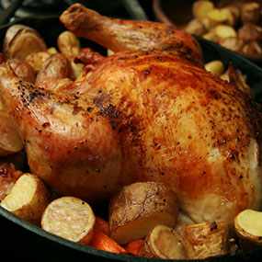

Slide 34
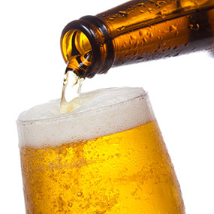
Alcohol intake
Drinking alcohol is a risk factor
for high blood pressure
Alcohol can prevent any blood pressure medications from working effectively
alcohol is full of calories and can lead to weight gain
If you drink too often or need help cutting back, speak with a healthcare provider

Slide 36
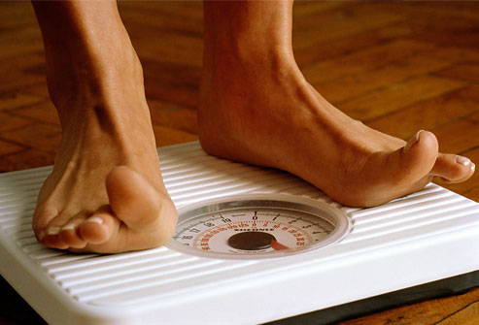
Weight reduction
overweight increases the risk of getting hypertension
A weight loss of just 10 pounds can make a difference in your blood pressure.

Slide 37
Treatment -2
2.Exercise
about 150 minutes per week of moderate
exercise- walking, bicycling, gardening,
or other aerobic exercise
Muscle-strengthening activities
at least twice a week
check with your doctor before starting
a fitness program

Slide 38
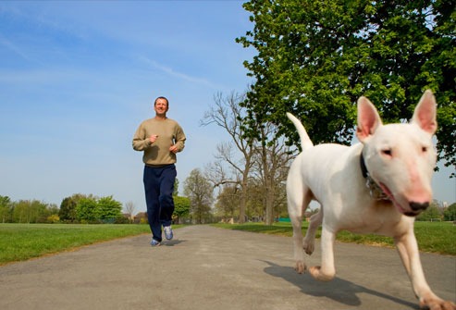

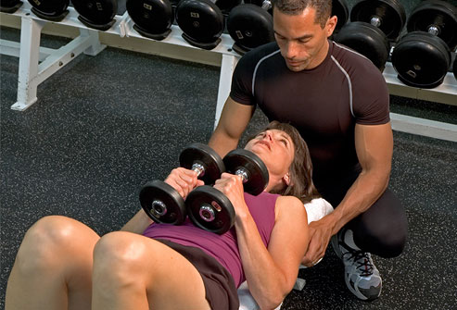
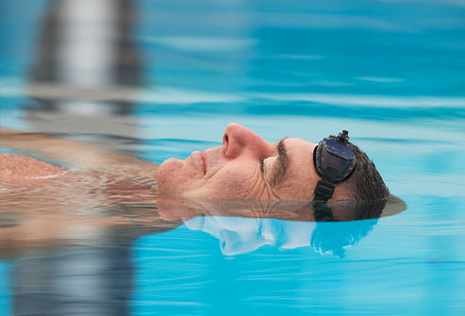

Slide 39
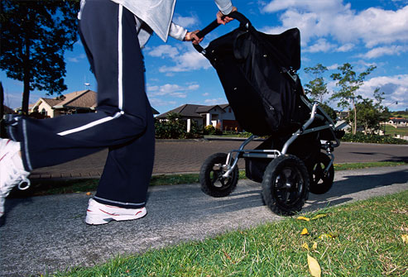
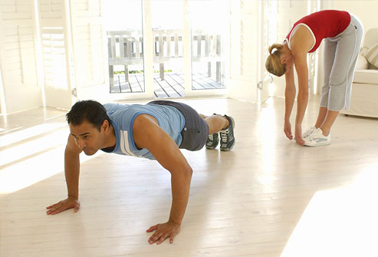
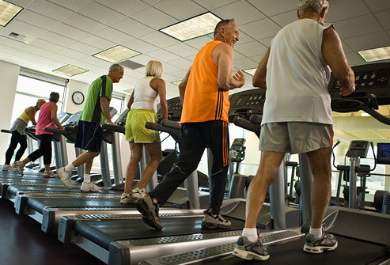
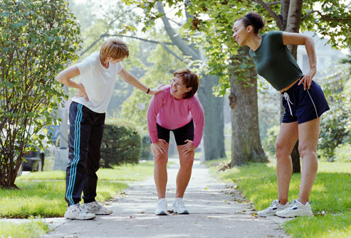

Slide 40
Put the Fun Back in Exercise
Find activities you enjoy and aim for 30 minutes a day of "exercise"
Daily housework, gardening, washing windows, using the stairs, carrying your groceries, walking at the mall, or riding bikes with the kids all add up to exercise that benefits your heart.
Increase activity by parking at the end of the lot, or get off the bus a stop early and walk to your destination

Slide 41
Resistance exercise
strengthen Your Heart
with free weights, weight machines, exercise bands, or by doing abdominal crunches or curl-ups
Resistance training helps reduce body fat, increase muscle mass, and boost your metabolic rate
Losing as little as 10 pounds can reduce
or help prevent high blood pressure in
many overweight individuals
Check with your doctor before starting
a new weight-training program

Slide 42
Treatment -3
3. drugs:
Diuretics (water pills)
the first medications recommended
urinate more frequently
Sometimes, diuretics deplete potassium levels as well, lead to muscle weakness, leg cramps, and tiredness
elevated blood sugars in people with diabetes
erectile dysfunction can occur

Slide 43
Treatment -3
(b)Beta-blockers
slowing the heart rate and thereby decreasing the workload of the heart
Side effects of beta-blockers can include dizziness, insomnia, fatigue, cold feet and hands, and
erectile dysfunction

Slide 44
Treatment -4
(c)ACE Inhibitors (angiotensin converting enzyme)
Dilates arteries and thus reduce BP
Side effects: skin rash, dry cough, dizziness
and elevated potassium levels
Women taking ACE inhibitors should not
become pregnancy

Slide 45
Treatment -5
(d) ARBs: angiotensin receptor blockers
Dilates the arteries and lowers blood pressure
ARBs can take a few weeks to work
Side effects: dizziness, muscle cramps, insomnia,
and elevated potassium levels
As with ACE inhibitors, women taking ARBs
should not become pregnant

Slide 46
Treatment -5
(e) Calcium Channel Blockers
Increases the strength of heart contractions
and relaxes the arteries
Side effects: palpitations, dizziness, swollen ankles
and constipation
They should be taken with food or milk
those taking calcium channel blockers should
avoid alcohol and grapefruit juice.

Slide 47

Living With High Blood Pressure
Hypertension often lasts a lifetime
so a careful management plan is essential
Keeping your blood pressure under control can lower your risk of heart disease, stroke, and kidney failure and can improve your quality of life
Exercise, weight management, and a healthy diet are important ways to help prevent high blood pressure

